Slide 1



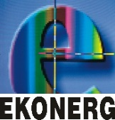


Enhanced environmental protection inspection for efficient control of air quality monitoring and of all entities under obligation within system of greenhouse gas emission allowance trading, in order to achieve better quality of air in Republic of Croatia
This project is funded by the European Union

Slide 2



THEME 1: The pollution of the atmosphere

Slide 3


1.5 SOURCES AND TYPES OF POLLUTION
European Union IPA 2013 Programme for Croatia
The atmosphere is considered polluted if air quality is such that it can harm the health, quality of life and/or adversely affect any component of the environment.
Air quality is a qualitative and quantitative evaluation of chemical composition of the atmosphere with respect to its impact on the environment and the health of the people and is directly connected to the global emissions of pollutants into the atmosphere that it can emitted from natural sources or direct and indirect human action.

Slide 4
1.5 SOURCES AND TYPES OF POLLUTION
European Union IPA 2013 Programme for Croatia
Pollutants in the air are divided:
according to the way that arise
according to the physical condition
Sources of pollution are divided:
according to the origin
according to the manner of release to the atmosphere

Slide 5
1.5 SOURCES AND TYPES OF POLLUTION
European Union IPA 2013 Programme for Croatia
Clasification of the pollutants in the air according to the manner in which arise
The PRIMARY will be emitted directly into the atmosphere from sources of pollution
The SECONDARY are created in the atmosphere by chemical reactions from primary pollutants
POLLUTANTS

Slide 6
1.5 SOURCES AND TYPES OF POLLUTION
European Union IPA 2013 Programme for Croatia
Clasification of the pollutants in the air according to the physical condition
GASEOUS
POLLUTANTS
SOLID

Slide 7
1.5 SOURCES AND TYPES OF POLLUTION
European Union IPA 2013 Programme for Croatia
The clasification of the sources of pollution according to origin
NATURAL volcanic eruptions, forest fires, sand storm
ANTHROPOGENIC factory, transport, waste disposal
SOURCES OF POLLUTION

Slide 8
1.5 SOURCES AND TYPES OF POLLUTION
European Union IPA 2013 Programme for Croatia
Clasification of the sources of pollution according to the manner of release to the atmosphere
POINTED
pollutants emitted through the discharge
MOBILE
Motor v., locomotives, boats, aircrafts
SOURCES OF POLLUTION
STATIONARY
DIFFUSE
pollutants NOT be emitted through the discharge

Slide 9
1.5 SOURCES AND TYPES OF POLLUTION
European Union IPA 2013 Programme for Croatia
Categorisation of sources of pollution for the purpose of making the cadaster of emissions
POINTED
SOURCES OF POLLUTION
IN-LINE
❶
❷
SURFACE
❸

Slide 10
1.5 SOURCES AND TYPES OF POLLUTION
European Union IPA 2013 Programme for Croatia
Categorization of sources of pollution for the purpose of making the cadastre of emissions
❶
Pointed sources of emissions are those that are located within the area of site bordered by a length of 1 km or less.
❷
In-line sources refer primarily to road and rail traffic that takes place by the line routes.
Surface sources refer to the total emissions from households, transportation and industry that are homogenous and densely arranged on a particular to a larger area.
❸

Slide 11
1.6 POLLUTORS
European Union IPA 2013 Programme for Croatia
The most practical categorization of pollutants is shown in the Decree on limit values of emissions from stationary sources in which pollutors are divided into groups according to the technological process. This should be added a large group of pollutants – motor vehicles whose emissions are subject to special regulations.

Slide 12
1.6 POLLUTORS
European Union IPA 2013 Programme for Croatia
MANUFACTURE OF NON-METALLIC MINERAL RAW MATERIALS AND METAL-PROCESSING
Installations for the production of cement in rotary kilns with a dry or wet process cement manufacturing plant in domed furnaces burning bauxite, dolomite, magnesite, limestone, gypsum, quarcite and chamotte treatment of perlite, shale or clay for oxides of sulphur.

Slide 13
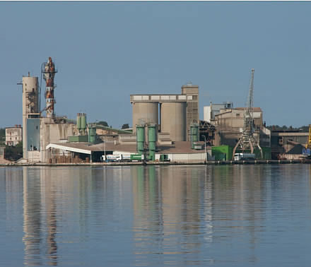
1.6 POLLUTORS
European Union IPA 2013 Programme for Croatia
Treatment of perlite, shale or clay for oxides of sulphur furnace for melting glass, the technological process of baking the clay-based ceramic products, technological process by hot galvanizing, the technological process of production, melting and alloying copper and zinc etc.

Slide 14
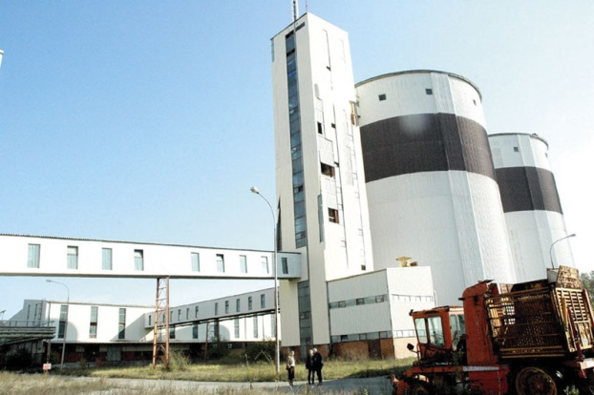
1.6 POLLUTORS
European Union IPA 2013 Programme for Croatia
CHEMICAL AND FOOD INDUSTRY
the technological process of obtaining sulphur,
the technological process of production of oil and gas,
the technological process of getting the soot, the technological process of obtaining carbon and at the technological process sugar beet processing and refining of sugar, the technological process of drying grass, the technological process of roasting coffee, coffee substitutes, grain and cocoa, drying oven in which combustion are used directly in the production process.

Slide 15
1.6 POLLUTORS
European Union IPA 2013 Programme for Croatia
VOLATILE ORGANIC COMPOUNDS FOR SPECIFIC ACTIVITIES
glue (adhesive) manufacture of wooden and plastic laminate, coating processes – painting metal, paper, leather, textiles, plastic, wood coating coil, dry cleaning manufacture of footwear manufacturing of coatings, varnishes, paint and glue, manufacture of pharmaceutical products, printing

Slide 16
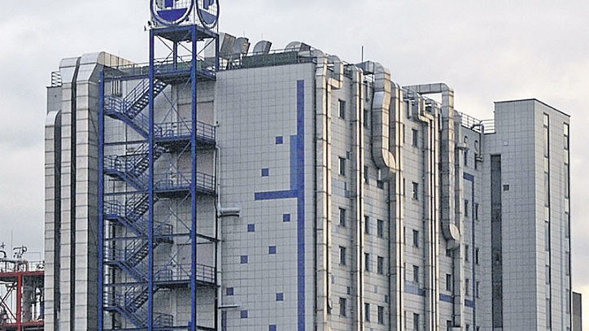
1.6 POLLUTORS
European Union IPA 2013 Programme for Croatia
production of rubber mixtures and products of rubber, surface cleaning of the extraction of vegetable oil and animal fat and finishing (varnishing) impregnation of wooden surfaces, surface coating wire thread

Slide 17
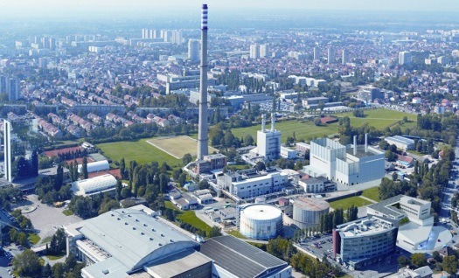
1.6 POLLUTORS
European Union IPA 2013 Programme for Croatia
DEVICES FOR COMBUSTION GAS TURBINE
small, medium and large combustion chamber with liquid of solid and gas fuels,
small, medium and large gas turbine,
combustion of waste

Slide 18
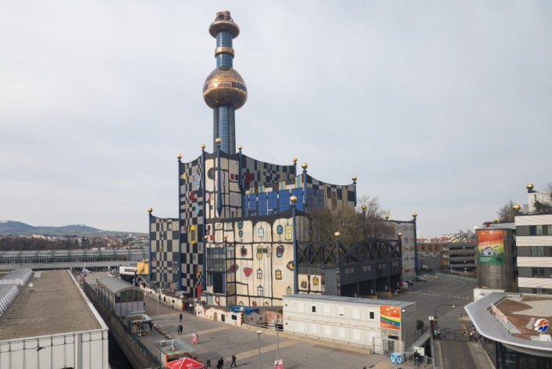
1.6 POLLUTORS
European Union IPA 2013 Programme for Croatia
ENGINES WITH INTERNAL COMBUSTION
engines that are used for the production of electricity, heat or mechanical energy production
PLANTS FOR THE INCINERATION OF WASTE AND PLANTS FOR THE COMBUSTION WASTE

Slide 19
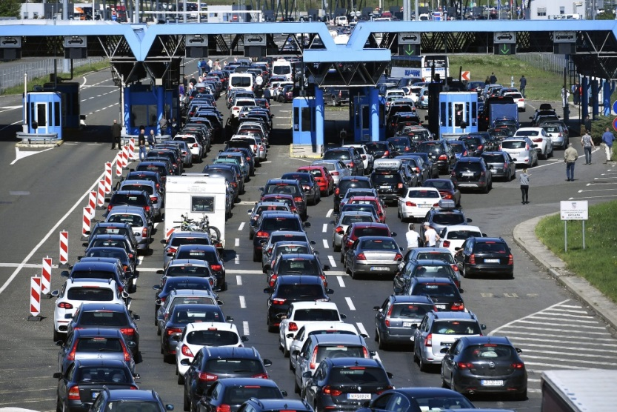
1.6 POLLUTORS
European Union IPA 2013 Programme for Croatia
MOTOR VEHICLES

Slide 20
1.7 POLLUTANTS
European Union IPA 2013 Programme for Croatia
Pollutants in the atmosphere there are in the two basic physical states: gas and solid (particles). In the air are tracked 3000 chemical compounds harmful to health, but for less than 200 of them are regulated by emissions from sources. The most commonly used standards for determining the air quality the following pollutants: particles, nitrogen oxides (NOx), ozone (O₃), benzene (C₆H₆) and sulphur dioxide (SO₂), while on the quality of life can negatively affect smelly gases like hydrogen sulfide (H₂S) and other reducibe sulfur compounds.

Slide 21
1.7 POLLUTANTS
European Union IPA 2013 Programme for Croatia
Primary pollutants
Primary pollutants (sulphur dioxide-SO₂, 5% of the total emission nitrogen oxides-NOx, carbon monoxide-CO, volatile organic compounds – VOC, carbon and noncarbon particles) will be emitted directly into the atmosphere from sources of pollution
Secondary pollutants
Secondary pollutants are created by chemical reactions in the atmosphere from primary pollutants. Among them is a very important nitrogen dioxide (NO₂) which is extremely harmful to human health, and his conversion in the atmosphere is associated with atmospheric ozone (O₃).

Slide 22
1.7 POLLUTANTS
European Union IPA 2013 Programme for Croatia
Secondary pollutants (continued)
Example 1.
NO + O₃  NO₂ + O₂
NO₂ + The Sun's lightNO + O
O + O₂  O₃
Conclusion:
If you want to reduce the concentration of NO₂ in air, it takes a very big reduction of emissions NO into the atmosphere

Slide 23
1.7 POLLUTANTS
European Union IPA 2013 Programme for Croatia
Secondary pollutants (continued)
In situations when it comes to antioxidants reactive hydrocarbons in photochemical reactions, it creates a highly reactive peroxide radicals who in the polluted atmosphere react with NO producing NO₂
Primjer 2.
NO + RO₂ (alkil peroxide)  NO₂ + RO
In this reaction RO₂ converts NO in NO₂ without spending molecules of ozone. In a very polluted atmosphere in the big cities the concentration of RO₂ are high because they originate from anthropogenic sources.

Slide 24
1.7 POLLUTANTS
European Union IPA 2013 Programme for Croatia
Secondary pollutants (continued)
In the appropriate chemical and physical conditions in the atmosphere caused the secondary particles. In some parts of the country secondary created particles make up more than 50% of the total concentration of particulate matter in the air.
THE SECONDARY PARTICLES
Basic components of the secondary particulate created
SULFATE
ORGANIC AEROSOL
NITRIC

Slide 25
1.7 POLLUTANTS
European Union IPA 2013 Programme for Croatia
Secondary pollutants (continued)
The first are the sulfate particles which are created in an atmosphere by oxidation from sulfur dioxide and participate in the creation of sulphur trioxide which very quickly reacts with water to produce sulfuric acid. In areas with low emissions of ammonia, sulfuric acid produces the largest part of the sulfate. In areas with heavy emissions of ammonia, which neutralizes the sulfuric acid, ammonium sulfate particles are created.

Slide 26

1.7 POLLUTANTS
European Union IPA 2013 Programme for Croatia
Secondary pollutants (continued)
Nitric oxide in the reaction with water in the atmosphere creates nitric acid that is present in the air in the form of vapour. Nitric acid (HNO₃) react or with ammonia (NH₃) or with calcium carbonate (CaCO₃) or sodium chloride (NaCl) product solid particle nitrate. It is the second most common component of the secondary particles are created. If it creates ammonium nitrate (NH₄NO₃), that the process is reversible.
In the conditions of high temperature and low relative humidity, ammonium nitrate can be dissociated in nitric acid. and ammonia.

Slide 27
1.7 POLLUTANTS
European Union IPA 2013 Programme for Croatia
Secondary pollutants (continued)
The third basic form of secondary particulate is a secondary organic aerosol that occurs by oxidation of organic substances that are created in the atmosphere in reactions with volatile organic compounds (VOC). Natural VOC as alpha pinene which emits the trees it is very reactive and in forested areas represents an important source of secondary organic aerosols. Anthropogenic VOCs-these in contaminated areas also produce secondary organic aerosol. The speed of creation of secondary particulate in the atmosphere is different, depending on their species and the physical conditions in the atmosphere. The formation of secondary aerosols is relatively slow process (24 hours or more), while the nitrates in the atmosphere produce much faster.

Slide 28
THANK YOU FOR YOUR ATTENTION !
Disclaimer: The contents of this publication are the sole responsibility of EKONERG – Energy Research and Environmental Protection Institute, Ltd. and can in no way be taken to reflect the views of the European Union
This project is funded by the European Union

